Slide 1
DR EBRAHIM POURAKBAR NEUROLOGIST

Slide 3
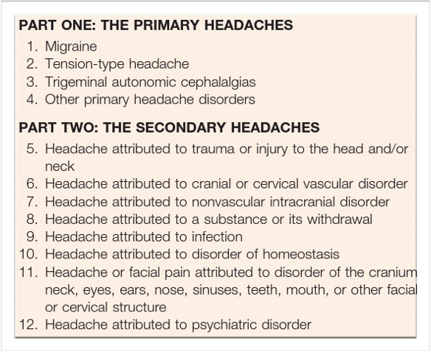
Classification of headache disorders

Slide 4
Inflammation of pain-sensitive structures produces the sever headache.
Headache is the most common symptom in acute bacterial meningitis (90%).
Chronic meningitis due to fungal and tuberculous infection may lead to headache that may be severe and unrelenting.

Slide 5
Bacterial infection of the CNS
Infections reach the intracranial structures:
Hematogenous
Extension from cranial structures to the brian
Iatrogenic

Slide 6
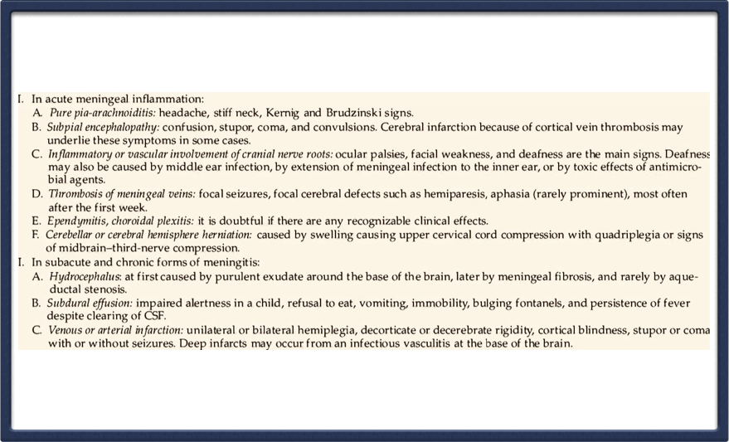
Pathological-clinical correlations in mennigeal reactions

Slide 7
Laboratory Findings in meningitis

Slide 8
1.Characteristic CSF formulas
Key points:
-NUT for the first few hour> 50000/mm³ possibility a abscess ruptured into a ventricle.
-RBC in CSF: Anthrax meningitis and Ebola virus , Hanta virus .
-Reduced CSF glu: Fungal and tuberculous meningitis,Sarcoidosis.
-Cultures of CSF prove to be positive in 70-80%.
-Polymerase chain reaction (PCR) most sensitivitie technique.

Slide 9
2.Imaging studies
In patients with bacterial meningitis, chest films are essential because they may disclose an area of pneumonia or abscess.
The CT scan is detecting paranasal sinusitis,mastoiditis,brain abscess and subdural empyema.
MRI will demonstrate meningeal reaction,venous occlusion and infarction.

Slide 10
“Case Report”

Slide 11
Patient was 24 yr male who was admitted in our hospital because of resistance headache, intermittent fever,consitutional symptoms from 2 months ago with progressive course.
He was perviously healthy and had no remarkable medical history

Slide 12
General examination:
She had oral temperature 38c .
Chest:clear,good breath sound.
Heart:systolic murmur 2/6 LBS.
No Lymphadenopathy.
Abdomen:Nl

Slide 13
Neurological examination :
Foudoscopy showed mild bilateral papilledema.
Motor:Nl
Sensory:Nl
Kerning ,Brudzinski’s sign and neck stiffness negative.

Slide 14
Differential Diagnosis
Infection | Endocarditis | TB and Fungal M | Focal brian infection
Neoplastic | Lymphoma | Metastasis
Inflammatory | Vasculitis disorder | Sarcoidosis

Slide 15
Laboratory tests:
CBC diff: Nl ESR:60 B/C:Neg
LFT:NL
HBSAg,HCV Ab,HIV Ab:Neg
Tumor marker protocol:NL
PPD had 5 mm induration.

Slide 16
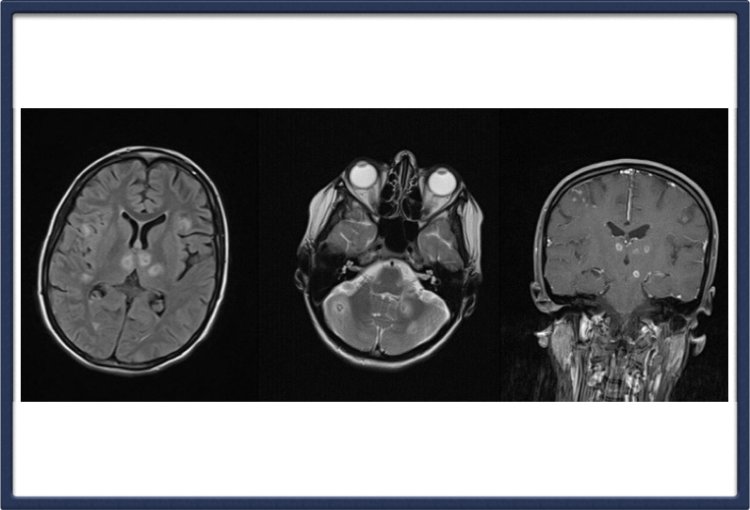
Brian MRI with and without contrast showed multiple lesions and some of them enhancing with central hypo intensity

Slide 17
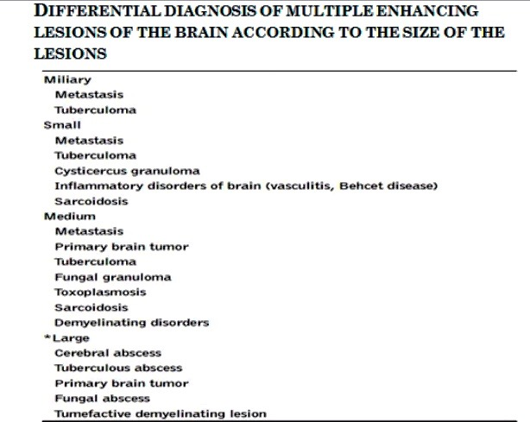

Slide 18
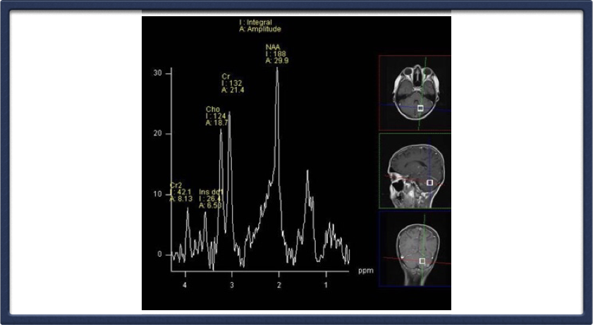
Brian MRS showed decreased NAA and no increased choline peak

Slide 19
Lumbar puncture was performed for the patient.CSF pressure was 300 mmH2O,Glucose 45 mg/dl,Protein 55 mg/dl, RBC :2 mm³,WBC:0 mm³
CSF smear and culture for Fungal and TB were negative.

Slide 20
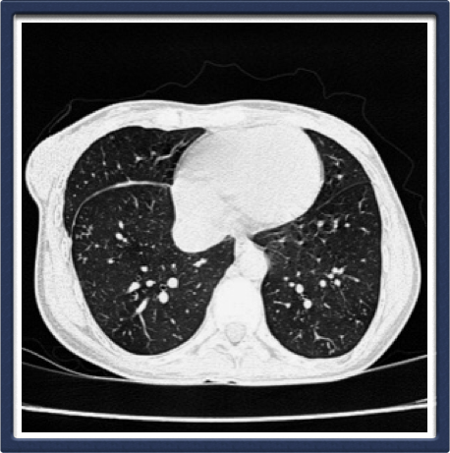
Chest CT scan showed Tree-bud pattern

Slide 21
BAL:Acute inflammatory fluid and Mycobacterium tuberculousis PCR was positive.

Slide 22
Centeral nervous system Tuberculousis

Slide 23
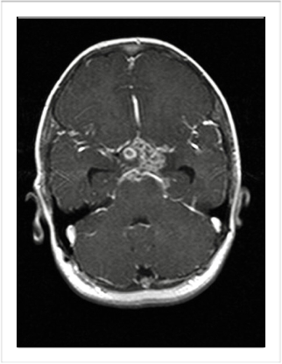
Tuberculous meningitis
The prodromal phase lasting 2-3 weeks.The meningitic phase include;meningismus , headache,vometing,lethargy,
varying of cranial N,papilledema. The paralytic phase include seizures,hemiparesis

Slide 24
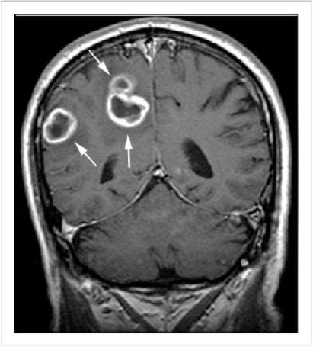
Tuberculoma
Tumor like masses of tuberculous.
2 _ 12 mm.
The most common site: gray white matter junction and the preventricular region.
many are unaccompanied by symptoms of focal cerebral disease.

Slide 25
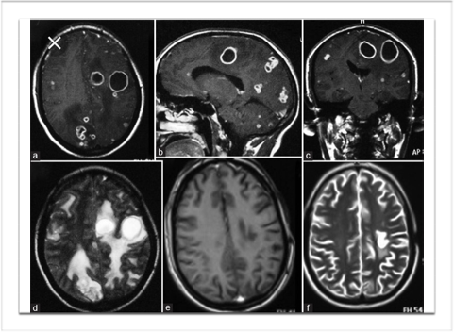
Tuberculous brian abscess
TB abscess have a more accelerated clinical course than Tuberculomas.

Slide 26
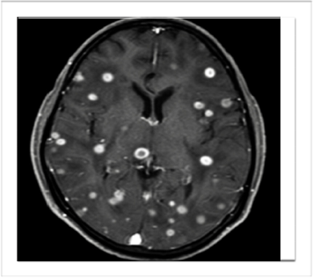
Miliary tuberculosis
All forms of progressive widely disseminated hematogenous TB even if the classical pathologic or radiologic finding are absent.
1.progressive primary disease
2. Reactivation of a late focus

Slide 27
Treatment
Intensive phase | INH,RIF,PZA | EMB | 2 months
Continuation phase | INH,RIF | 9-12 months
Anti-TB chemotherapy regiment | INH,RIF | 18 months

Slide 28
Adjunctive corticosteroids:
Dexamethasone
Perdnisolone;Adult 60mg/day
Child 2-4mg/kg/day
25mg>
8mg/day
25mg<
12mg/day

Slide 29
Our patient was immediately treated with INH,RIF,EMB,PZA and vitamin B6 .After 21 days he became afebrile ,general condition and compression headache improved better. The patient was discharge fron hospital after 21 days and treatment was continued by INH and RIF for one year.

Slide 30
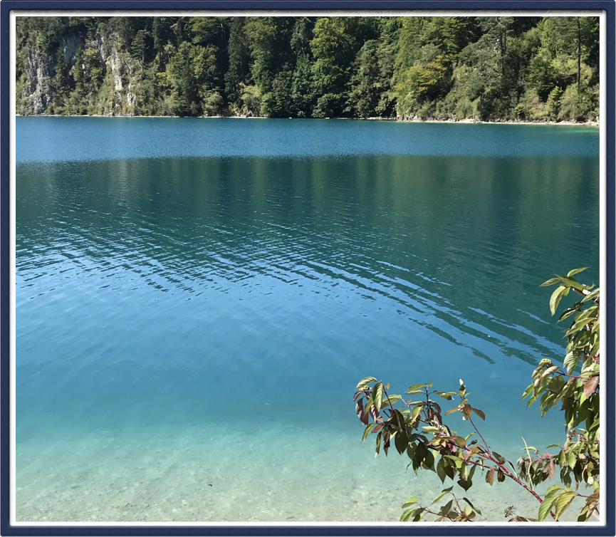
Live in such a way that those who know you but don’t God will come to know God because they know you

Slide 31
Belong to the
International Headache Society (IHS)
To advance headache science, education and management, and promote headache awareness worldwide.
Free of charge Associate Membership
Online access to Cephalalgia
Online access to The Neuroscientist
Access to the IHS Online Learning Centre
Early access to IHS International Guidelines
Benefit from key Exchange Programmes and Awards
Fellowships / Scholarships
Travel Grants
Visiting Professors
Headache Master Schools
Headache/neurology specialists from Iran can join
free of charge as an Associate Member
See the IHS website for more information
and to join online
www.ihs-headache.org

