Slide 1
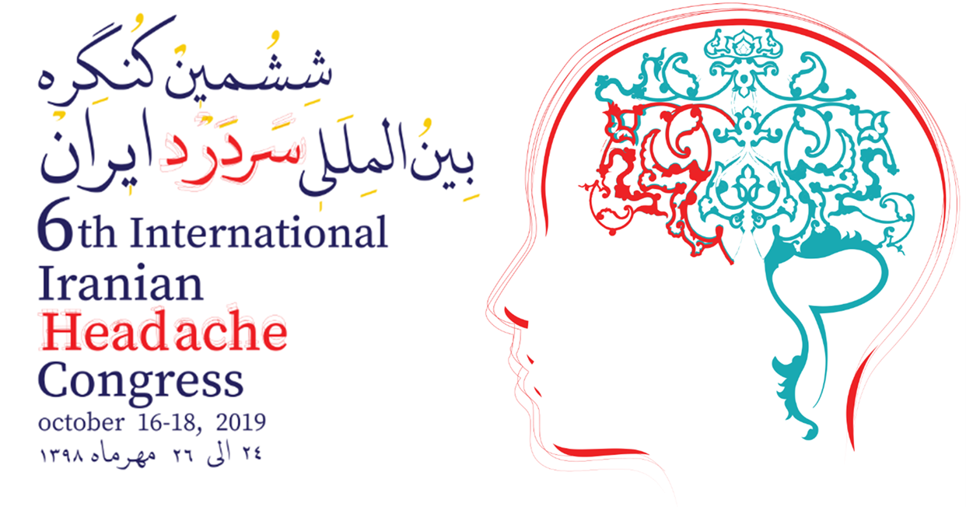
Neuromodulation in the treatment of primary headaches
Parisa Emami,MD
Assistant professor of neurology
Isfahan university of medical sciences

Slide 2
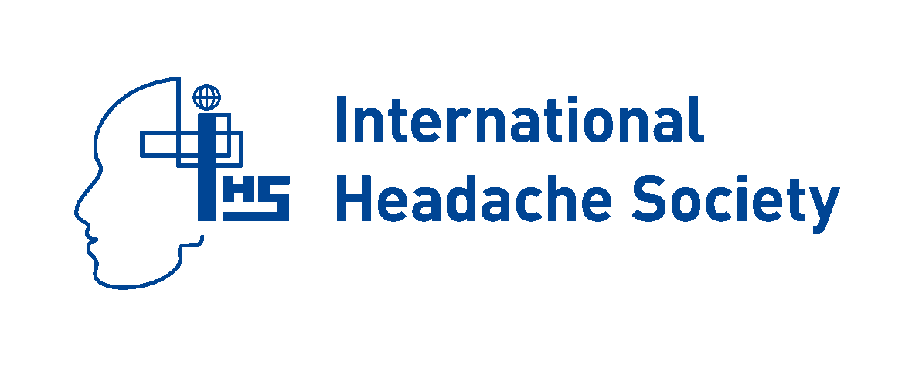

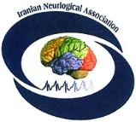

Outline:
Introduction to neuromodulation
Neuromodulation subtypes
  Non-invasive neuromodulation
    Supraorbital nerve stimulation and the Cefaly device
    Vagus nerve simulation and the gammaCore device
    Transcranial magnetic stimulation and the SpringTMS device
  invasive neuromodulation
    Occipital nerve stimulation
    SPG stimulation and the Pulsante SPG microstimulator
    Deep brain stimulation (ventral tegmentum/posterior hypothalamic region

Slide 3
Introduction:
Headache disorders are among the most common and disabling medical conditions worldwide.
Pharmacologic acute and preventive treatments are often insufficient and poorly tolerated, and the majority of patients are unable to adhere to their migraine treatments due to these issues.
With improvements in our understanding of migraine and cluster headache pathophysiology, neuromodulation devices have been developed as safe and effective acute and preventive treatment options.

Slide 4

Introduction:
Of alternative treatments, neurostimulation is not a novel approach. In the 1st century, Emperor Claudius’ doctor, Scribonius Largus, recommended application of a live electric fish (Torpedo marmorata) on the site of head pain.
From an abortive standpoint,there are several reasons including that existing acute medications might not be effective or tolerated, or are contraindicated due to medical comorbidities.
Neurostimulation therapies with peripheral or central targets may help these patients.

Slide 5
Neuromodulation works by manipulating central or peripheral pain pathways using electrical or magnetic impulses to modulate pain pathways in such a way to reduce pain levels.
There are multiple targets for neurostimulation in headache.
This type of treatment can use for acute treatment or preventive therapy.

Slide 6
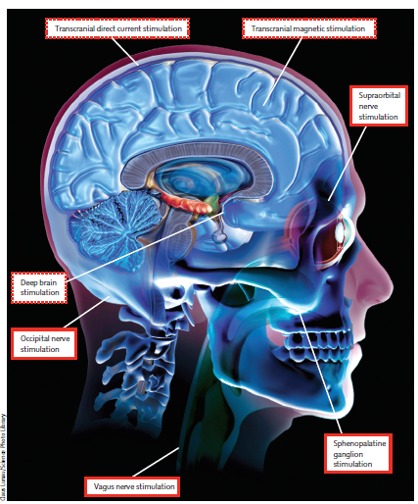

Slide 7
Currently available non-invasive devices target :
  supraorbital (electrical stimulation )
  vagus nerves (electrical stimulation)
  the cortex (magnetic stimulation).
Available invasive stimulation techniques involve:
  the occipital nerves (peripheral targets)
  SPG (peripheral targets)
  the ventral tegmental area (central target).

Slide 8
Such techniques may help those patients who wish to avoid, are refractory to or intolerant of previous drug therapies.
Devices that allow acute treatment of attacks may be help those who cannot use triptans or in whom acute medications are ineffective or overused.
Trials of nonpharmacologic management have produced average reduction in migraines of 40–50%, closely paralleling results obtained in trials of preventive drugs

Slide 9
There are currently three FDA-approved neuromodulation devices on the market.
  The Single Pulse Transcranial Magnetic Stimulator :It was first approved for the acute treatment of migraine with aura, and has recently been approved for the preventive treatment of migraine. (December 2013)
  The Transcutaneous Supraorbital Neurostimulator: It is currently FDA-approved for both preventive and acute treatment of migraine. (preventive use in March 2014 and for abortive use in September 2017)
  The Vagus Nerve Stimulator :It is approved for the acute treatment of attacks in patients with episodic cluster headache as well as for the acute treatment of migraine pain. (January 2018)
All being non-invasive and easy to use, the new, wearable neuromodulation devices are attractive alternatives for patients living with migraine.

Slide 10
Remote Electrical Neuromodulation (REN)
Latest FDA cleared device for migaine is Nerivio Migra® neuromodulation device. On May 28, 2019, Nerivio Migra® was cleared by the FDA as a noninvasive neuromodulation device for acute treatment of migraine with or without aura in adults who do not have chronic migraine.
The device is worn on the upper arm and uses smartphone-controlled electronic pulses to create a conditioned pain modulation response.
The effectiveness of Nerivio Migra® was demonstrated in a randomized, double-blind, placebo-controlled study. (66.7% achieved pain relief, 37.4% experienced freedom from pain and 46.3% found relief of most bothersome symptoms two hours after treatment).
It will be available in the United States this year.

Slide 11
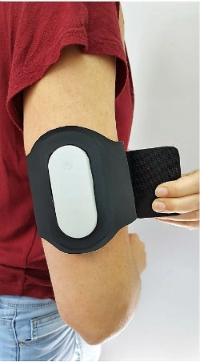
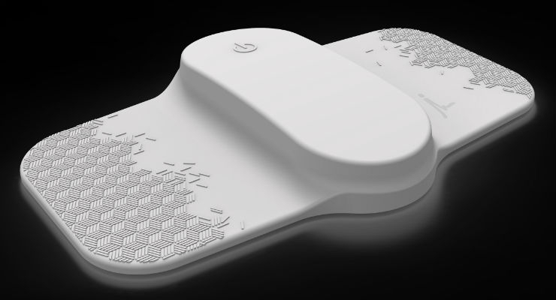

Slide 12
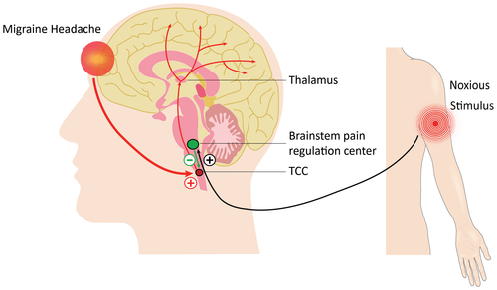
Remote Electrical Neuromodulation (REN) Relieves Acute Migraine: A Randomized, Double‐Blind, Placebo‐Controlled, Multicenter Trial
Headache: The Journal of Head and Face Pain, Volume: 59, Issue: 8, Pages: 1240-1252, First published: 09 May 2019, DOI: (10.1111/head.13551)
Notes:
Schematic illustration of the principle of operation of REN. The device stimulates C and Aδ noxious sensory fibers of the upper arm above their depolarization thresholds but below the perceived pain threshold. The noxious information reaches the brainstem through the ascending pain pathway (black). This information activates the descending pain inhibitory pathway (green), involving the brainstem pain regulation center (which includes the PAG, RVM, and subnucleus reticularis dorsalis [SRD]), and the release of serotonin and noradrenalin, which inhibit incoming messages of pain in the trigeminal cervical complex (TCC) that occur during a headache of a migraine attack (red). PAG = periaqueductal gray; RVM = rostral ventromedial medulla; SRD = subnucleus reticularis dorsalis; TCC = trigeminal cervical complex.
IF THIS IMAGE HAS BEEN PROVIDED BY OR IS OWNED BY A THIRD PARTY, AS INDICATED IN THE CAPTION LINE, THEN FURTHER PERMISSION MAY BE NEEDED BEFORE ANY FURTHER USE. PLEASE CONTACT WILEY'S PERMISSIONS DEPARTMENT ON PERMISSIONS@WILEY.COM OR USE THE RIGHTSLINK SERVICE BY CLICKING ON THE 'REQUEST PERMISSIONS' LINK ACCOMPANYING THIS ARTICLE. WILEY OR AUTHOR OWNED IMAGES MAY BE USED FOR NON-COMMERCIAL PURPOSES, SUBJECT TO PROPER CITATION OF THE ARTICLE, AUTHOR, AND PUBLISHER.

Slide 13
Supraorbital nerve stimulation and the Cefaly device
The trigeminovascular system has a crucial role in head pain. The supraorbital nerve is a branch of the first division of the trigeminal nerve.
The Cefaly device is an external transcutaneous supraorbital nerve stimulator that is battery powered and applied to the forehead using a headband-like device.

Slide 14
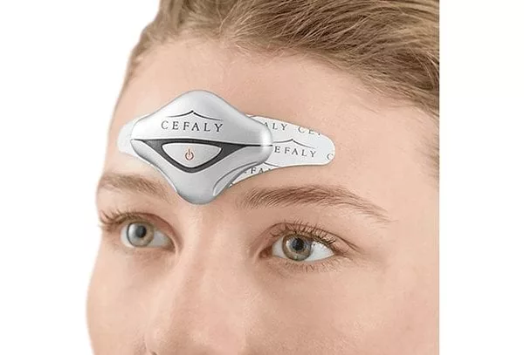

Slide 16
Possible role for the Cefaly device
Acute treatment of episodic migraine
The FDA-approved device now has an acute setting, in which the e-TNS is activated for 60 minutes to eliminate or reduce acute migraine pain. An RCT of acute benefit was the basis for FDA approval.
After 1 hour of treatment, pain intensity was reduced by 57.1% (3.22 ± 2.40), and at 2 hours, pain was reduced by 52.8% (2.98 ± 2.31)
Preventative treatment of episodic migraine
In early March 2014, the FDA approved for use a transcutaneous electrical nerve stimulation device for the prevention of migraine. The FDA approval was based upon two studies that showed safety and tolerability of the device, with the smaller of the two studies showing a modest benefit in the reduction of days per month with migraine and less migraine medication usage than those who were using the placebo device.

Slide 17
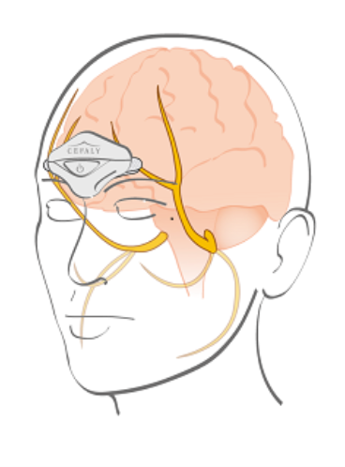
Proposed mechanism of action
We do not yet know the mode of action of supraorbital nerve stimulation in migraine.
Supraorbital nerve stimulation probably winds down the trigeminal pain pathways through altering activity within the trigeminovascular system both peripherally and centrally.
  Cefaly acute setting (high frequency, single long session) produces a sedative effect on the nervous system that relieves headache pain.
  Cefaly prevent setting (low frequency, daily short sessions) restores progressively a normal metabolism in the fronto-temporal cortex of migraineurs

Slide 18
The adverse effects of the Cefaly device appear mild and transient. Some patients experience :
  paraesthesia
  drowsiness
  worsening of headache
  reversible forehead irritation

Slide 19
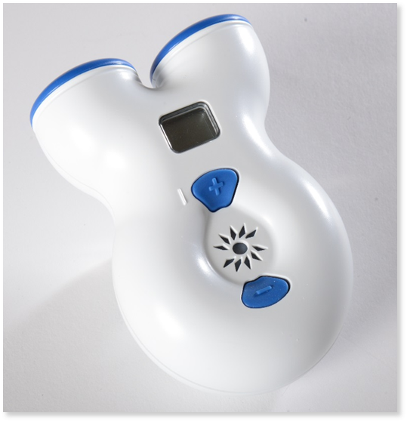
Vagus nerve simulation and the gammaCore device
The vagus nerve is a mixed motor and sensory nerve that is important in controlling autonomic responses;it projects to several higher centres that are important in pain regulation.
Following reports of migraine improvement in patients receiving vagus nerve stimulation for epilepsy, the nerve became a target for headache treatment.
Noninvasive vagal nerve stimulation (nVNS) is delivered with a hand-held device that modulates and inhibits vagal afferents while not activating vagal efferents that cause bradycardia and bronchospasm.

Slide 20
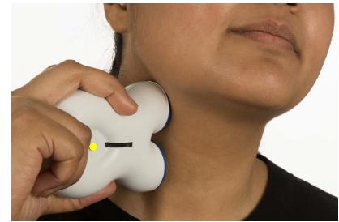

Slide 21
how to use gammaCore (nVNS):
1.Find the correct treatment location and positioning on the neck to activate the vagus nerve
2.Apply the supplied gel to the stimulation surfaces of the device, turn it on, and position it on the neck
3.Adjust the intensity level to what's right
for you

Slide 22
Proposed mechanism of action:
This device appears to work by at least 3 mechanisms:
  suppression of cortical spreading depolarization,
  inhibition of thalamocortical pathways,
  modulation of central trigeminovascular and trigeminocervical pathways.

Slide 23
Possible role of the gammaCore device
Adjunctive use for the preventive treatment of cluster headache in adult patients.
The acute treatment of pain associated with episodic cluster headache in adult patients.
The acute treatment of pain associated with migraine headache in adult patients.
NOTE:
The safety and effectiveness of gammaCore (nVNS) have not been established in the acute treatment of chronic cluster headache
gammaCore has not been shown to be effective for the preventive treatment of migraine headache

Slide 24
Safety and efficacy of gammaCore have not been evaluated in the following patients, and therefore gammaCore is NOT indicated for:
  Patients with an active implantable medical device, such as a pacemaker, hearing aid implant, or any implanted electronic device
  Patients diagnosed with narrowing of the arteries (carotid atherosclerosis)
  Patients who have had surgery to cut the vagus nerve in the neck (cervical vagotomy)
  Pediatric patients
  Pregnant women
  Patients with clinically significant hypertension, hypotension, bradycardia, or tachycardia

Slide 25
Adverse Effects are transient, and for the most part, very mild
Most common Adverse Effects:
  Mild to moderate neck pain (local discomfort)
  skin irritation
  Worsening of pain
  Oropharyngeal pain
  Paresthesias
  Facial twitching/spasms

Slide 26
Transcranial magnetic stimulation and the SpringTMS device
Transcranial magnetic stimulation applies a brief single magnetic pulse to the scalp and underlying cortex.
This pulse induces electrical fields in the cortex, altering neurotransmitter release (modifies excitability of cortical areas )and disrupting cortical spreading depression.
The SpringTMS device is a rechargeable handheld device that delivers a single pulse of magnetic stimulation to the back of the head.

Slide 27
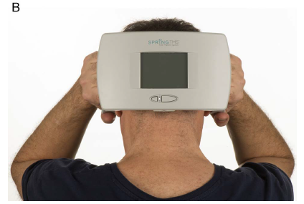
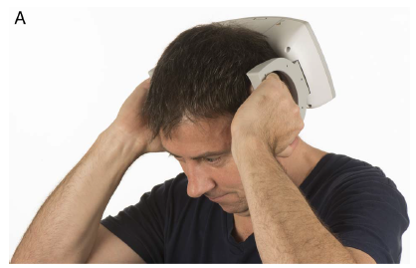
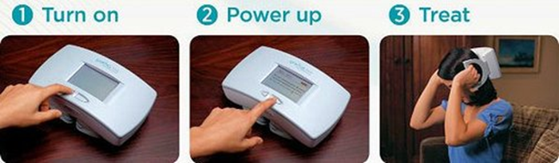

Slide 28
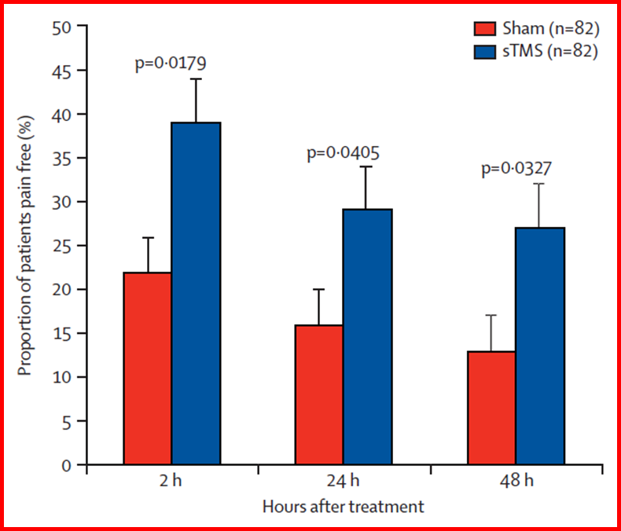
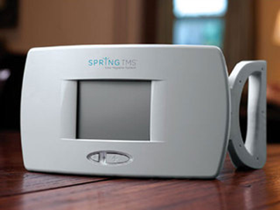
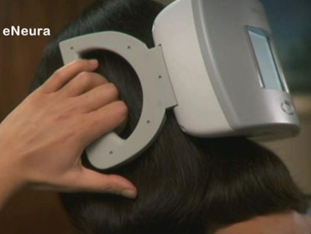
Acute treatment of M W/Aura
TX;2 pulses 30 sec apart within 1 hour of aura onset

Slide 29
Proposed mechanism of action
1. terminates cortical spreading depolarization
2. pulsing the magnet posteriorly modulates and inhibits thalamocortical pain pathways.
Because patients can use the device both acutely and preventively, FDA approval set a maximum of 17 pulses per day.

Slide 30
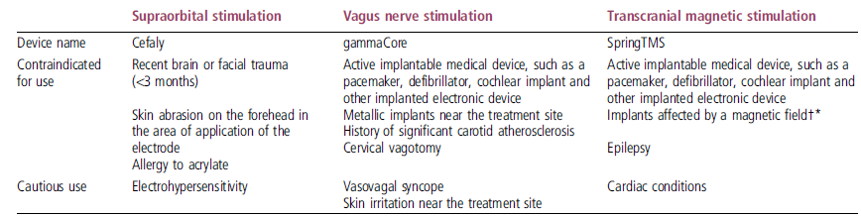
Contraindications for non-invasive neurostimulation
Devices should not be used while driving or operating machinery.
*Dental implant and fillings are not a contraindication to using transcranial magnetic stimulation.
†Including aneurysm clips or coils, cerebrospinal fluid shunts, bullets or pellets lodged in the head or upper body, metal plates, screws, staples or sutures in skull, neck, shoulders, arms or hands, electrodes, radioactive seeds, stents, filters, metallic heart valves, facial tattoos with metallic ink.

Slide 31
Occipital nerve stimulation
Occipital nerve stimulation has also been found to be effective for the treatment of migraine. Investigators have also found some evidence for its usefulness in other primary headache disorders, such as cluster headaches, hemicrania, and occipital neuralgia.
However, it is one of the oldest and most invasive of the neuromodulation techniques currently available. (evolving as a treat­ment since 1993)
The occipital nerves are a target for stimulation due to the anatomical overlap between the trigeminal andcervical afferents in the trigeminocervical complex. This allows stimulation of the occipital region to modulate pain in the trigeminal distribution.
Occipital nerve stimulation is a non-destructive surgical procedure where electrodes are placed subcutaneously in the occipital region and then wired to a battery pack in the chest or abdomen .

Slide 32
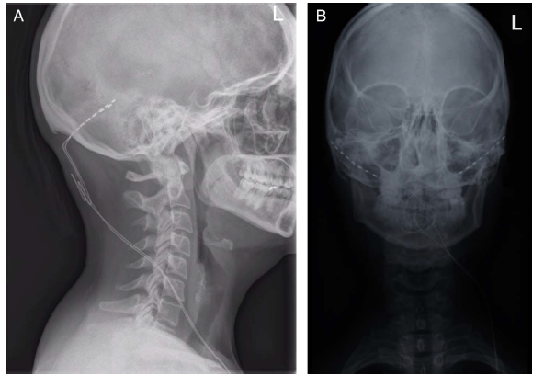

Slide 33
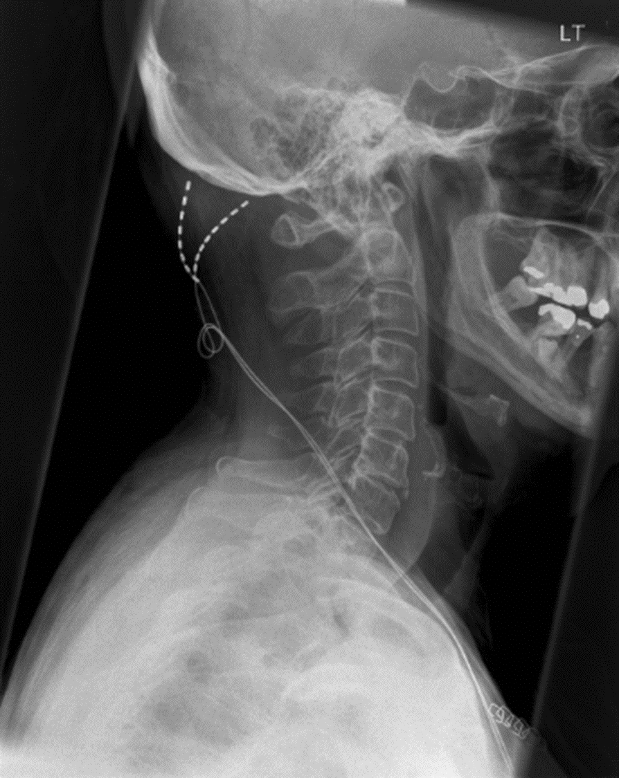
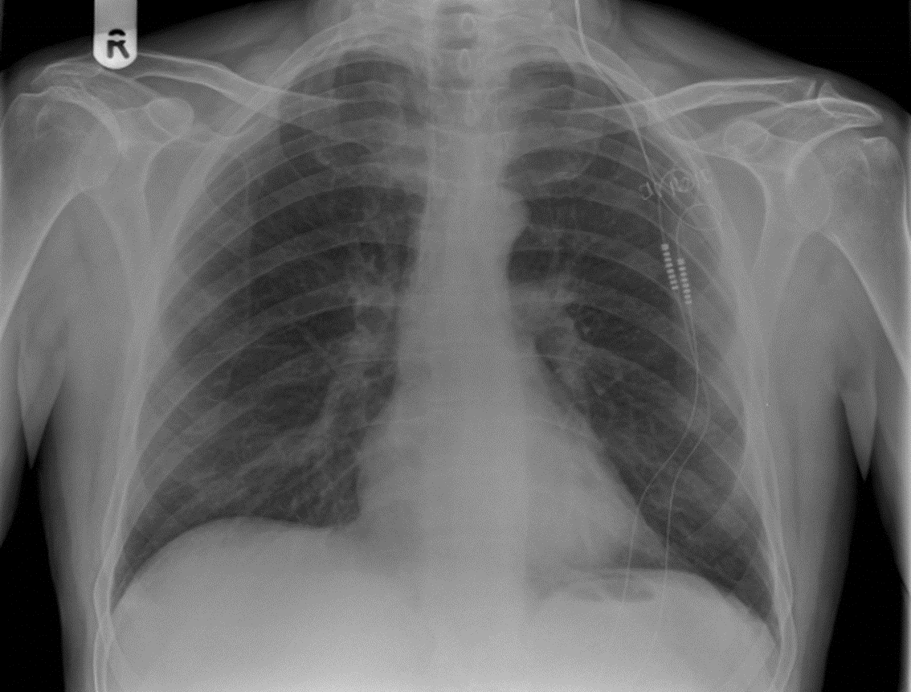
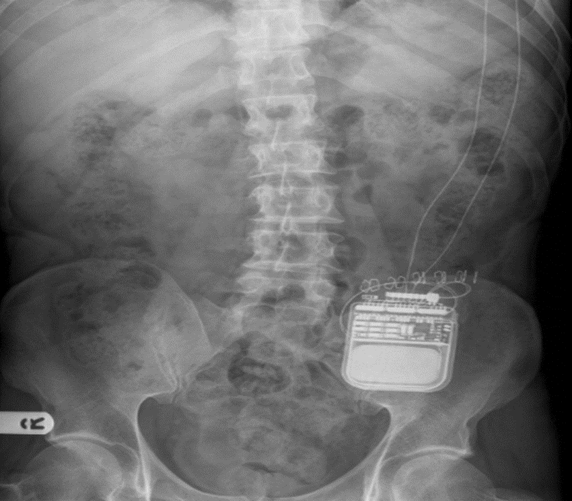

Slide 34
Evidence for occipital nerve stimulation
Open-label studies have shown possible efficacy in preventing chronic migraine, chronic cluster headache , hemicrania continua and short-lasting unilateral neuralgiform headache attacks.
The average response rate is around 70% for chronic cluster headache and 56% for chronic migraine.

Slide 35
Using occipital nerve stimulation
Bilateral leads should be implanted even with unilateral headaches
Following implantation, the device is programmed to give a comfortable level of paraesthesia in the distribution of the greater occipital nerve.
The device is left on at all times, and generally patients are advised not to alter the settings unless the paraesthesia becomes painful or unnoticeable.
Stimulation is not to be altered during acute attacks.
It is important that patients are followed up frequently in the early postoperative period to ensure optimum stimulation settings are used.
If after 1 year of continuous comfortable stimulation there has been no change, then it is highly unlikely that the patient will gain any benefit. In these patients, we switch off the device for at least 3 months before offering removal to ensure they have not failed to recognise the extent of any improvement.

Slide 36
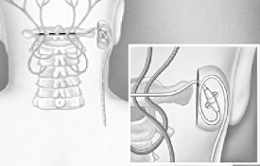
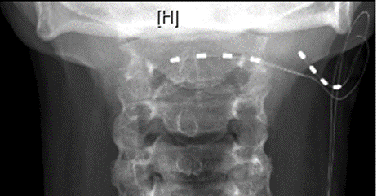
Adverse event rates vary between centres but are reduced if the procedure is carried out in specialist centres.
Hardware-related adverse events that may require additional surgical input include lead migration (13%), lead fracture (4%) and erosion of an electrode through the skin (4%).
Other commonly reported adverse events include pain over the battery site (18%), infection (10%) and painful stimulation (17%).

Slide 37
Proposed mechanism of action
The exact mechanism of action of occipital nerve stimulation is unclear, and it is likely to act via a non-specific modulatory effect on pain-control systems.
The findings support the hypothesis that occipital nerve stimulation activates descending pain-control systems and restores equilibrium in antinociceptive pathways.

Slide 38
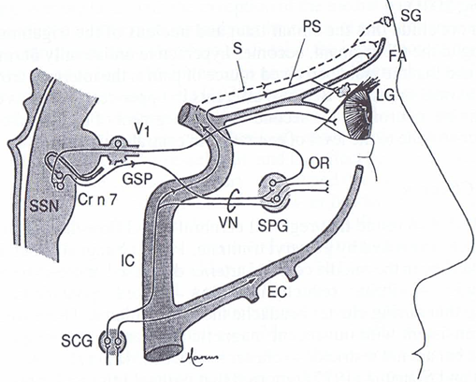
SPG stimulation and the Pulsante SPG microstimulator
The SPG is an extracranial structure lying in the pterygopalatine fossa containing sympathetic and parasympathetic neurones. SPG Innervations: Sympathetic postganglionic pathways pass through the SPG without synapsing; Parasympathetics synapse in SPG .

Slide 39
Possible uses of SPG stimulation
The procedure could be considered as an acute, and possibly a preventative , treatment for those with medically refractory chronic cluster headache who have failed all available medical treatments.
At present, recommendations are that only those with strictly unilateral cluster attacks should be implanted.
NOTE : The device may be particularly useful in those patients who have not responded to or who have contraindications to triptans and those who have a high number of daily attacks.

Slide 40
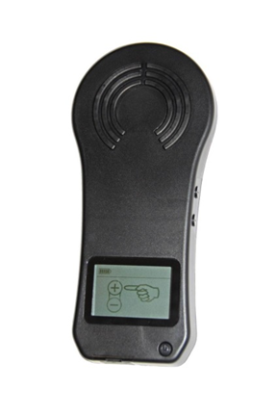
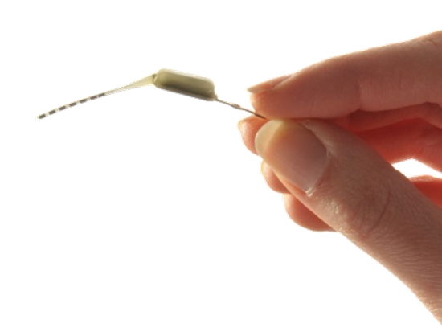
Using SPG stimulation
Miniaturized implant stimulates the SPG
Change of paradigm - Wirelessly powers and controls the neurostimulator with no external batteries or wires
Implanted through the mouth
On-demand, patient-controlled therapy
Rechargeable through USB port
Internet connected

Slide 41
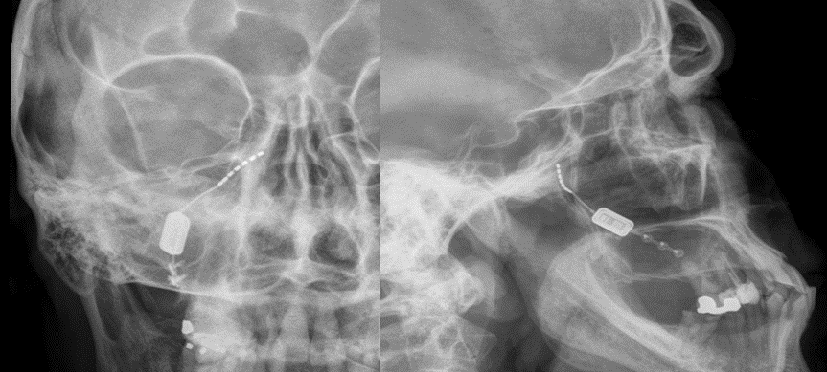
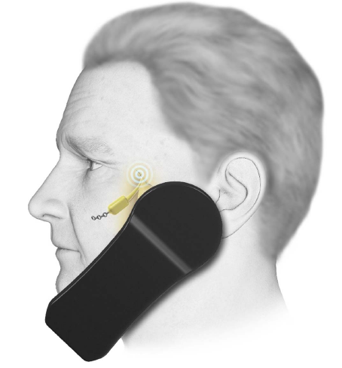

Slide 42
At the start of an attack, the patient places the handset to the cheek above the implant and activates the device. Stimulation should be continued for at least 15 min. After this time, if the attack continues, the patient should switch off the device and use their normal rescue medication.
Even if patients stop having regular attacks, then the device could be used as a preventative giving 15 min of stimulation once or twice a day.
Adverse events include misplacement or migration of the leads (15%), infection (6%) or mild transient sensory deficit in the maxillary division of the trigeminal nerve (81%).

Slide 43
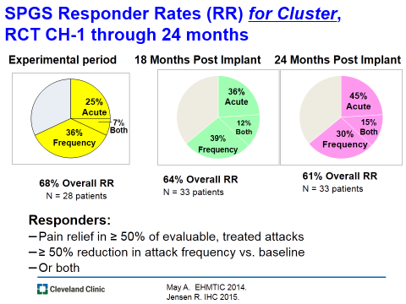

Slide 44
Proposed mechanism of action
Cluster headache pathology probably involves interaction between trigeminal inputs and the cranial parasympathetic outflow from the superior salivatory nucleus via the SPG. Postganglionic fibres from the SPG innervate facial structures and meningeal blood vessels. (referred to as the trigemino-autonomic reflex).
SPG stimulation probably works by interrupting this system, resulting in the termination of acute attacks via a direct effect on the trigeminal inputs and parasympathetic outflow; it may prevent attacks by inducing long-term changes in neurotransmitter release.

Slide 45
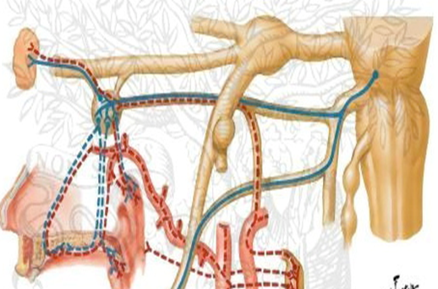
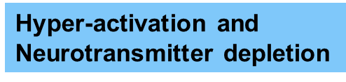




Hypotheses: Information block on outflow; Stimulation depletes neurotransmitters, resulting in ↓outflow

Slide 46
Deep brain stimulation (ventral tegmentum/posterior hypothalamic region)
Functional neuroimaging techniques show that the posterior hypothalamic region is activated during cluster headache attacks. Stimulation of this region increases blood flow through areas of the pain matrix.
Deep brain electrodes were first implanted in this region to treat a patient with cluster headache in 2001. Further work localised the site of implantation to the ventral tegmental area rather than the posterior hypothalamus. (ipsilateral to the site of pain)

Slide 47
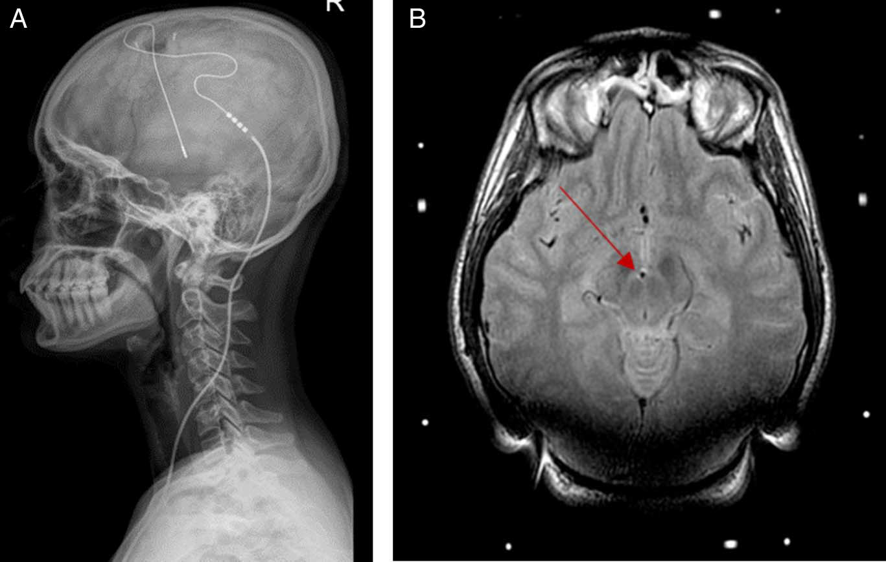

Slide 48
Possible uses of deep brain stimulation
Patients should have proven refractory to all other treatments, including other neurostimulation techniques, and need to have normal brain anatomy.
Implantation must only occur in highly specialist centres and all candidates must have been approved by a multidisciplinary team, including a psychologist.
There is no evidence to support the use of deep brain stimulation in chronic migraine.

Slide 49
Using deep brain stimulation
Deep brain stimulation is reserved for patients with end-of-line refractory chronic cluster headache.
Following implantation, a specialist programmes the device, which is then left switched on at all times.
Unlike the other invasive neurostimulation devices, the patient is advised not to change their stimulation
settings.
Initially patients should be followed up 3-monthly to ensure the stimulation settings are adequate. Current implants involve a nonrechargeable battery with a lifetime of 5–7 years.
As with occipital nerve stimulation, if there is no improvement after 1–2 years of stable, adequate stimulation, then the treatment is unlikely to help.

Slide 50
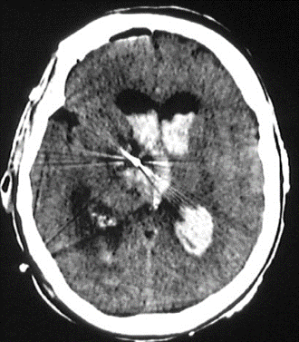
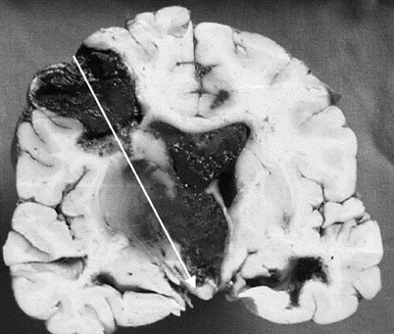
Deep brain stimulation carries the potential for serious risk. There is a single reported case of a patient with cluster headache dying from a postoperative intracerebral haemorrhage. The overall incidence of symptomatic haemorrhage in any deep brain stimulation surgery is around 2%,
Other adverse events from our patients include transient diplopia or vertigo with changes in programming (almost universal), neck stiffness (12%) and pain over the implant (19%).

Slide 51
Proposed mechanism of action
Ventral tegmental area deep brain stimulation probably acts upon pain circuits involved maintaining chronic cluster headache.
Stimulation of this region activates the hypothalamus, thalamus, somatosensory cortex, anterior cingulate, and the ipsilateral trigeminal nucleus and ganglion. These structures are also active during acute cluster attacks.
On the basis that the therapeutic effect takes several weeks, it has been hypothesised that ventral tegmentum deep brain stimulation induces a functional modulation of the pain processing network in cluster headache rather than pure inhibition of hypothalamic activity.

Slide 52

Thanks for your attention

Slide 53
Belong to the
International Headache Society (IHS)
To advance headache science, education and management, and promote headache awareness worldwide.
Free of charge Associate Membership
Online access to Cephalalgia
Online access to The Neuroscientist
Access to the IHS Online Learning Centre
Early access to IHS International Guidelines
Benefit from key Exchange Programmes and Awards
Fellowships / Scholarships
Travel Grants
Visiting Professors
Headache Master Schools
Headache/neurology specialists from Iran can join
free of charge as an Associate Member
See the IHS website for more information
and to join online
www.ihs-headache.org

