Slide 1
بسم الله الرحمن الرحیم
Shaghayegh. H. Javanmard
MD. PhD
Professor of Physiology

Slide 2
Cortical spreading depression and migraine

Slide 3
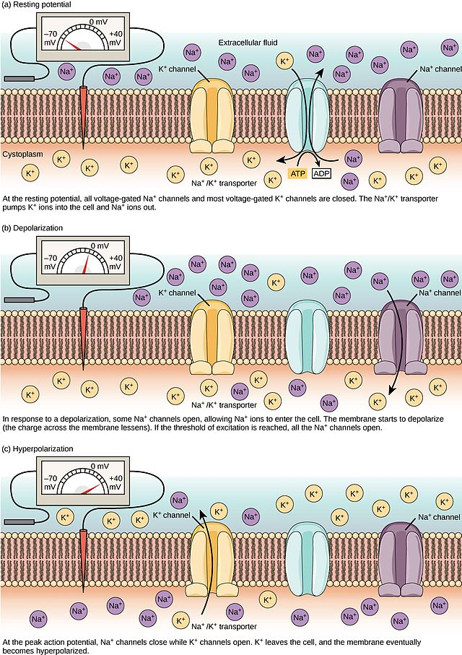

Slide 4
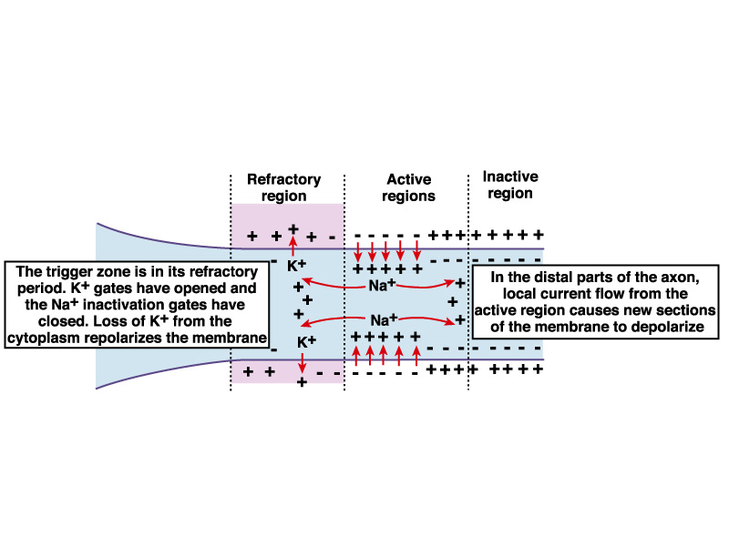

Slide 5
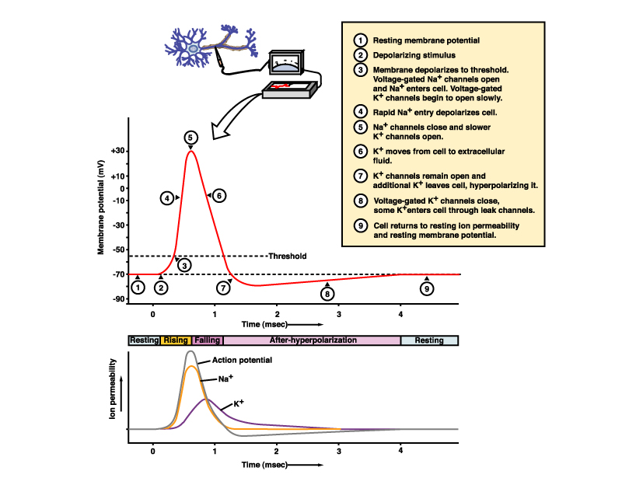

Slide 6
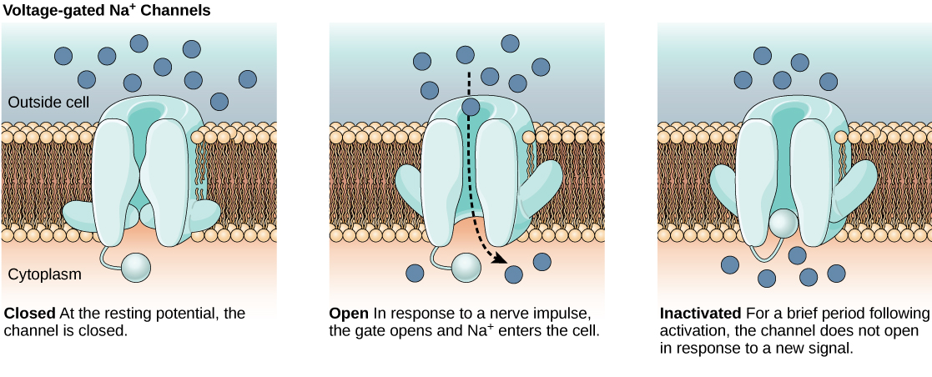

Slide 7
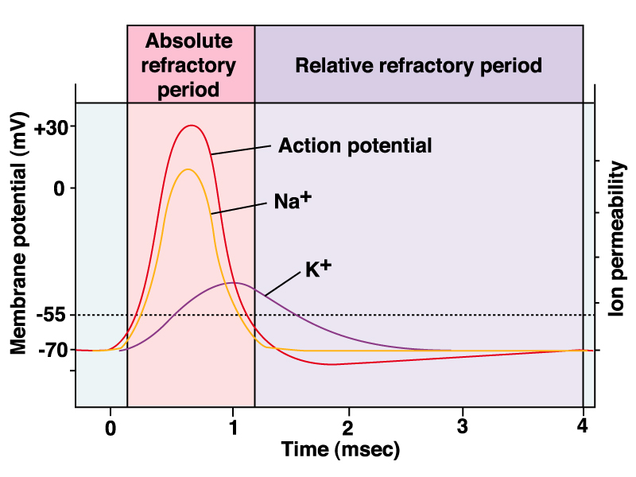

Slide 8
The Na/K-ATPase pump is crucial in restoring ion homeostasis.
The brain consumes about 20% of the body’s basal energy
Na/K pumps use about half of this 20% share in maintaining ionic gradients.

Slide 9
Neurons cannot fire action potentials after sustained depolarization
Spreading depolarization is characterized by near-complete sustained depolarization in neurons, neuronal membrane resistance, and neuronal swelling and distortion of dendritic spines
As a consequence, spreading depolarization causes brain electrical silence which was termed spreading depression of brain electrical activity by Aristides Leão in 1944

Slide 10
Glial cells play a critical role, serving to buffer K+ ions in the extracellular space and absorb the glutamate released from excitatory synapses
increased electrical activity is coupled with the release of vasodilator factors, such as NO and arachidonic acid metabolites, which increase local blood flow to meet increased energy expenditure
The neurovascular response

Slide 11
CSD can trigger trigeminal nociception
The migraine pain is caused by activation and sensitization of the trigeminovascular pain network, beginning with the activation and sensitization of trigeminal sensory afferents, that innervate cranial tissues, such as the meninges, and second order neurons in the trigeminal nucleus caudalis (TNC); the TNC projects directly or indirectly to different areas of the brainstem and forebrain

Slide 12
The vessel response is strongly nonlinear…
While moderate increases in extracellular potassium cause vasodilation, stronger increases induce vasoconstriction.
The neurovascular response to CSD typically shows a triphasic pattern (constriction, dilation, and then prolonged slight constriction)

Slide 13
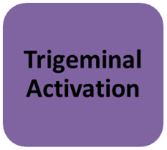
CSD and Migraine
CSD

