Slide 1


Slide 2
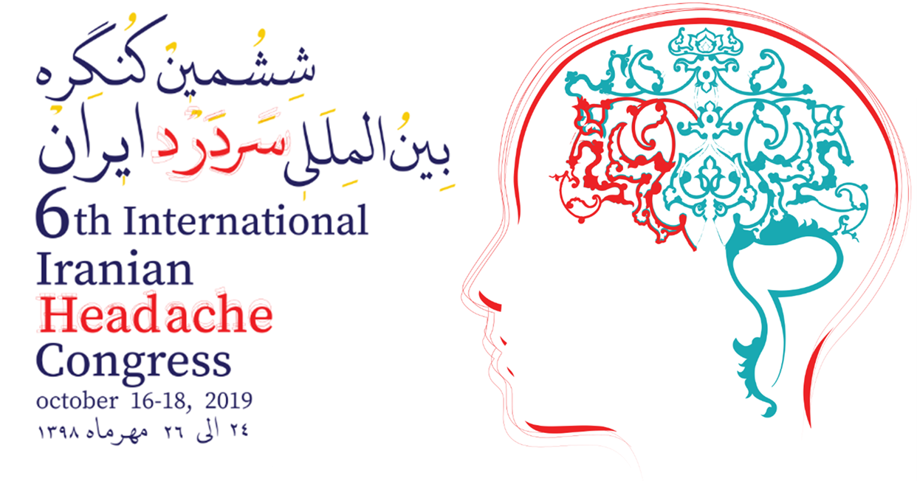


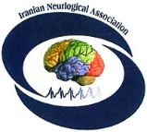

Physiatric Interventions in
Headache
By :
S. Khosrawi MD , Physiatrist
Dept. of Physical Medicine & Rehabilitation
IUMS, Isfahan, Iran
khosrawi@med.mui.ac.ir

Slide 3
Main rehabilitative goal in headache management
سر درد
درد سر

Slide 4
The three major primary headache disorders are :
migraine, cluster, and tension.
Headache treatment consists of :
pharmacologic & non-pharmacologic methods
including lifestyle changes as preventive measures.

Slide 5
Basics of Non-Drug Treatment
Learn appropriate prevention and treatment
  Reduce triggers :foods, drugs, activities, smoking,…
  Normalize sleeping and eating
  Avoid frequent abortive treatment
Physical therapy:(short term and focus on exercise rather than on modalities)
  Treat postural dysfunction and myofascial pain
  Reduce spasm (biofeedback, …)
  Exercise (relaxation , aerobic ,…)
Behavioral & Psychotherapy
Advanced procedures

Slide 6
Migraine Headache
Lifestyle modifications :
Regular and adequate sleep and hydration
Regular relaxation & aerobic exercise
(Recent studies suggest that moderate intensity aerobic exercise 30-40 minutes 3-5 times/week is as effective as topiramate and relaxation training).
Migraine trigger avoidance :
Any stressful event, caffeine overuse or withdrawal, missed meals, alcohol, smoking, odors, ?? chocolate or dairy products, processed meats, obesity, …

Slide 7
Migraine Headache
Non-pharmacologic treatment :
cognitive-behavioral therapy
biofeedback-assisted relaxation
acupuncture ?? (weak evidence)
physical therapy ?
Onabotulinum toxin type A injections into the pericranial musculature received FDA approval for treatment of chronic migraines in 2010.
Transcutaneous supraorbital nerve stimulation (t-SNS) , transcranial magnetic stimulation (TcMS) and caloric vestibular stimulation (CVS) have received clearance from FDA.

Slide 8
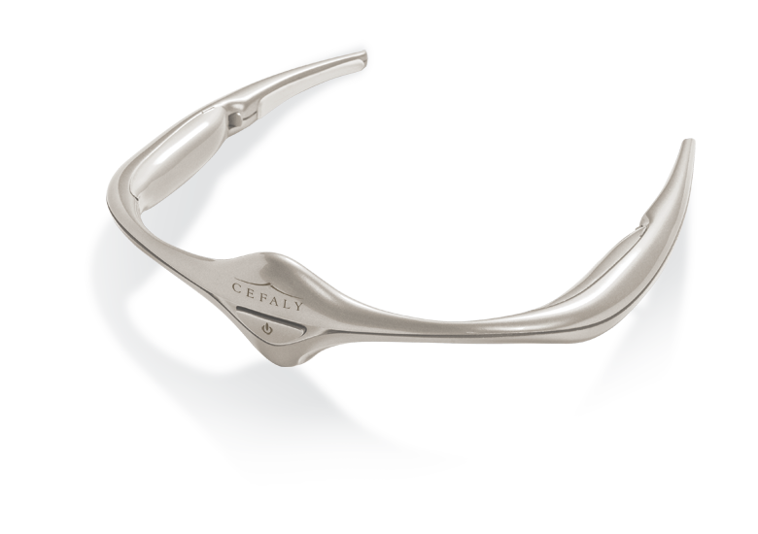
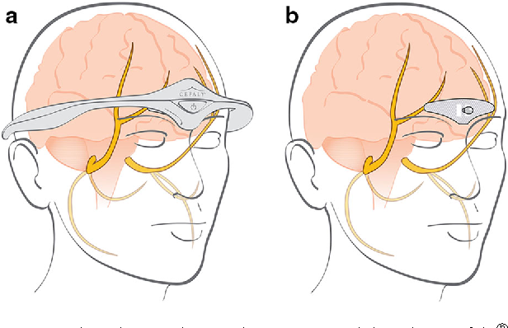
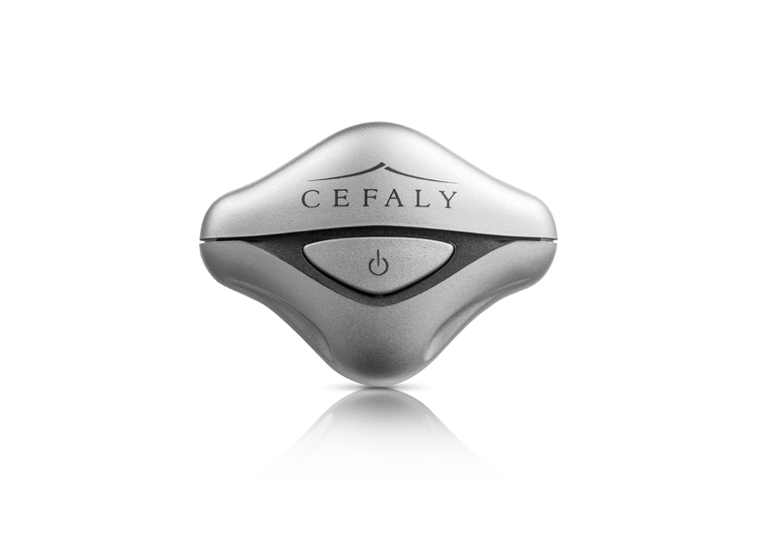
e-TNS (External Trigeminal Nerve Stimulation) s-TNS (Supraorbital Transcutaneous Nerve Stimulation)
FDA clearance
Migraine

Slide 9
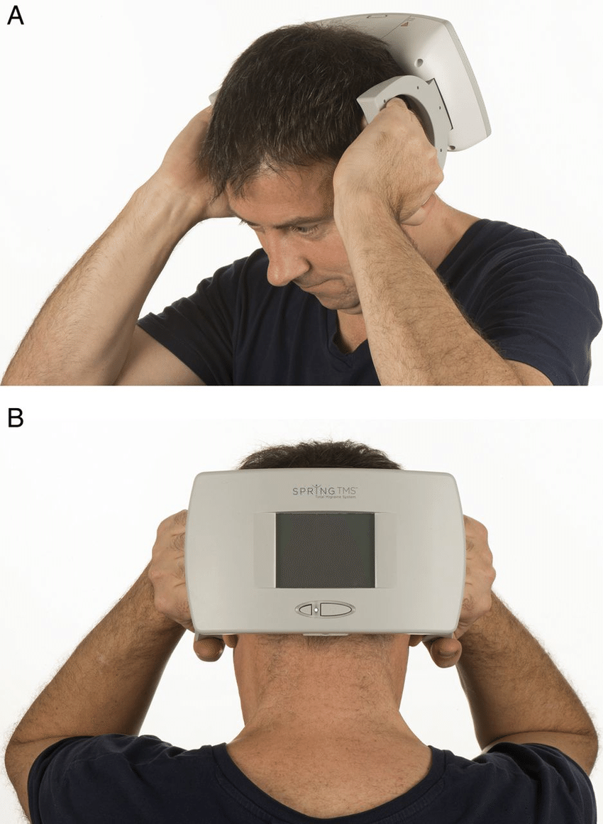
Transcranial Magnetic Stimulation (TcMS)
FDA clearance
Migraine

Slide 10
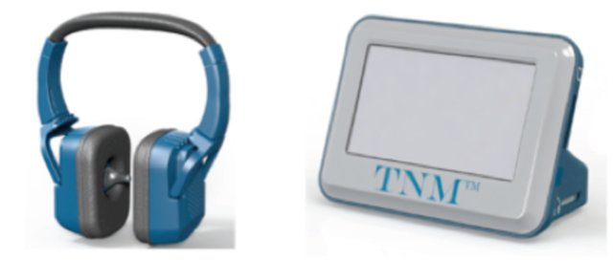
Caloric Vestibular Stimulation (CVS)
FDA clearance
Migraine

Slide 11
Cluster Headache
Lifestyle modification : alcohol avoidance and stress reduction.
Non-pharmacologic therapy :
100% oxygen (12-15 L/min. at headache onset by non-rebreather mask for at least 20 minutes aborts headache in 80% of patients)
Vagus nerve stimulation (FDA approval for acute episodic cluster)
In cases of refractory cluster headache:
neuromodulation (sphenopalatine ganglion stimulation ) or
ablative surgical procedures on the 5th. cranial nerve (radiofrequency, cryotherapy, and alcohol techniques)

Slide 12
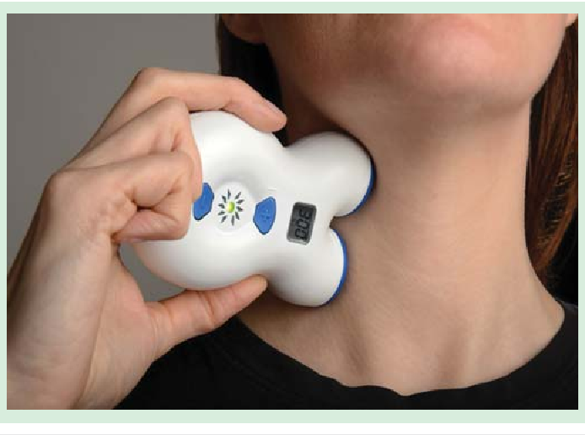
Vagus Transcutaneous Nerve Stimulator (v-TNS)
FDA approval
Cluster

Slide 13
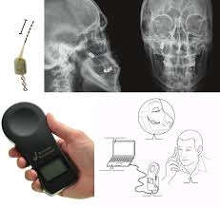
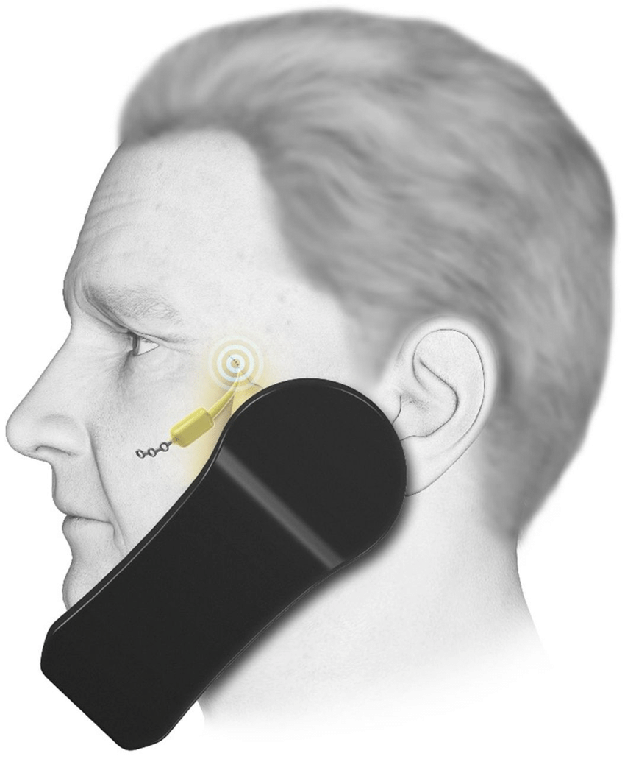
Sphenopalatine ganglion microstimulator
Cluster

Slide 14
Tension Headache
Lifestyle modification :
Regular and adequate sleep and aerobic exercise
Non-pharmacologic therapy:
Biofeedback (thermal or electromyographic)
Physical therapy

Slide 15
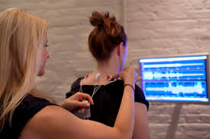
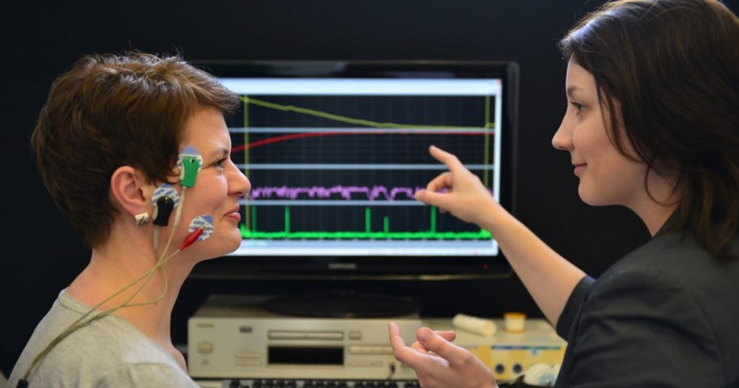
Electromyographic Biofeedback
Tension

Slide 16
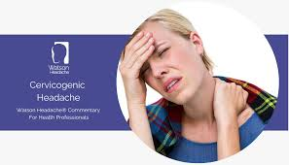
Occipital Neuralgia
Synonyms:
Cervicogenic headache
Occipital headache
Occipital neuropathy
Occipital neuritis
Occipital myalgia-neuralgia syndrome
Cervical migraine
Arnold neuralgia

Slide 17
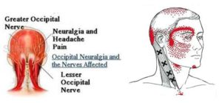
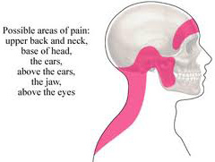
The International Headache Society categorizes occipital neuralgia as a cranial neuralgia and defines it with three diagnostic features:
1*paroxysmal lancinating, sharp pain in the distribution of the occipital nerves
2*tenderness over the affected nerves
3*temporarily relieved by local anesthetic block

Slide 18
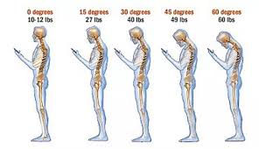
Pain provokers :
exposure to cold is a common trigger
sensory triggers to the face or skull e.g. brushing the hair or moving the neck
pressure of the head on a pillow
prolonged abnormal fixed postures that occur in reading or sleeping positions and hyperextension or rotation of the head to the involved side, …

Slide 19
In chronic continuous occipital neuralgia, the patient may experience spasm & painful attacks that last for days to weeks.
On occasion, patients may report other autonomic symptoms concurrently, such as nausea, vomiting, photophobia, diplopia, ocular and nasal congestion, tinnitus, and vertigo.
On examination, pain, allodynia or hyperalgesia is generally reproduced by palpation of the greater and lesser occipital nerves.

Slide 20
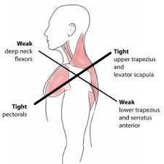
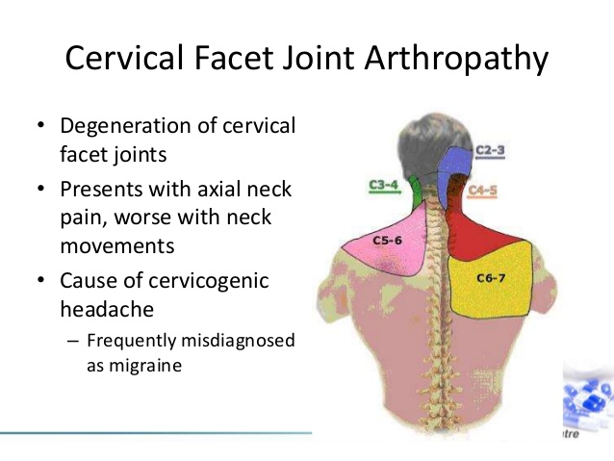
Proposed causes include :
myofascial tightening
trauma of C2 nerve root (whiplash injury)
prior skull or suboccipital surgery
hypertrophied atlantoepistrophic (C1-C2) ligament
sustained neck muscle contractions ( postural )
spondylosis of the cervical facet joints
other type of nerve entrapment

Slide 21
The diagnosis of occipital neuralgia is generally made clinically .
Imaging may help confirm the diagnosis when there is an anatomic cause.
Diagnostic local anesthetic nerve blocks may be required for a definitive diagnosis to be obtained.

Slide 23
Pain Management
Pharmacologic :
NSAID’s or acetaminophen
Tricyclic antidepressants
Muscle relaxants
Anticonvulsants (such as carbamazepine, gabapentin, pregabalin)
Rehabilitative treatments that may help include :
Heat or cold therapy
Massage
Avoidance of excessive cervical spine flexion-extension or rotation
Acupuncture
TENS

Slide 24
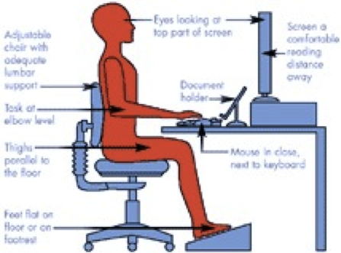
Exercise
Stretching and strengthening exercises for the paracervical and periscapular muscles, particularly if the condition is provoked by cervical spine or trunk movement.
Postural training and relaxation exercises
Principles of ergonomics should be addressed.

Slide 25
Other rehabilitative methods
Manual therapy, including spinal manipulation and spinal mobilization, has been used.
There is clearly a need for more well designed RCT’s to evaluate these therapies because there are serious risks if it is improperly performed.

Slide 26
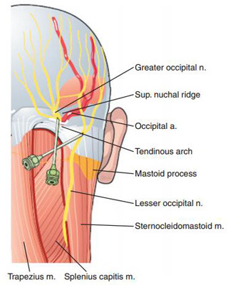
Greater or lesser occipital nerve blockade with a local anesthetic is diagnostic and therapeutic.
50% of patients will experience more than 1 week of relief after one injection.
An ultrasound-guided technique was recently demonstrated and postulated as superior to traditional landmark techniques.
Localized trigger point injections may be beneficial.
The addition of a cortisone preparation is controversial,
but it may provide additional benefit.
Botulinum toxin A injection into the greater occipital nerve
has also been described , but the evidence is limited.
Its use is currently ranked as grade C )the weakest strength.(

Slide 27
Dorsal rhizotomy of C1, C2, C3, and C4 has been described;
about 71% to 77% of patients report significant benefit.
Pulsed radiofrequency of occipital nerve was shown to improve symptoms for 6 months or more in patients with treatment-refractory occipital neuralgia.
Neurostimulation ( trans- or subcutaneous implantation of electrical leads in the suboccipital region ).
A variety of surgical procedures for occipital neuralgia have been proposed, such as neurectomy, C1-C2 decompression, C2 ganglionectomy.

Slide 28
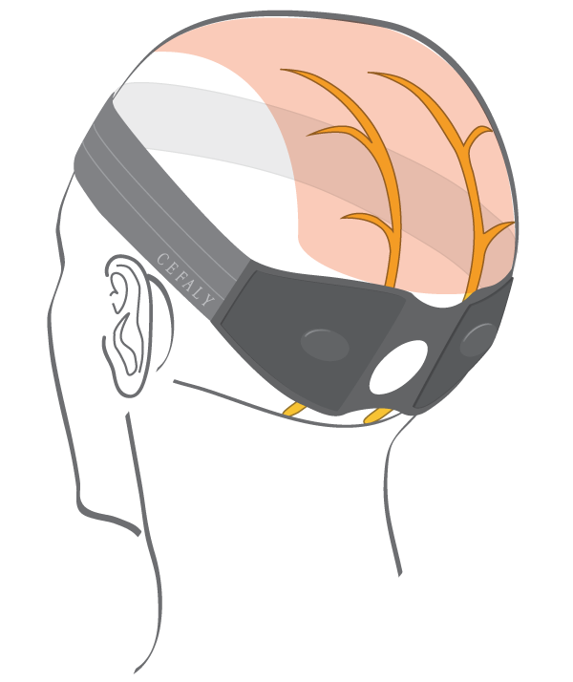
e-ONS (External Occipital Nerve Stimulation s-TNS (Suboccipital Transcutaneous Nerve Stimulation)
Occipital Neuralgia

Slide 29
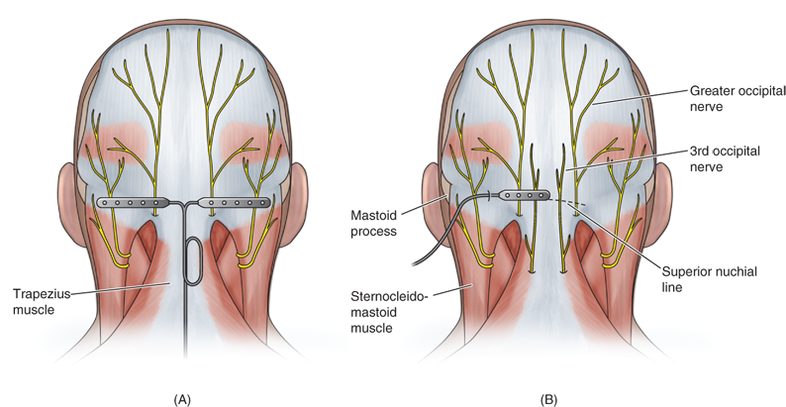
Neurostimulation
(subcutaneous)
Occipital Neuralgia

Slide 30
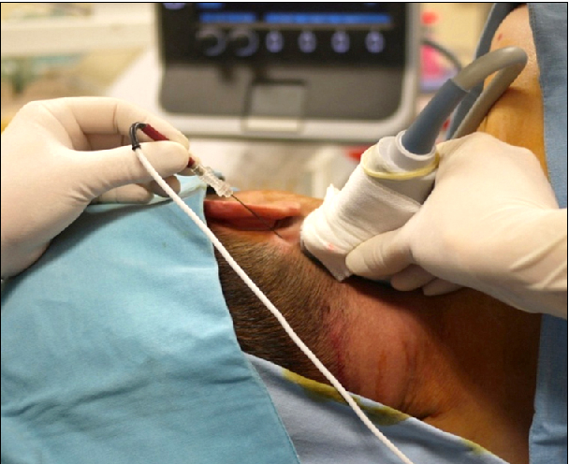
Ultrasound-guided Pulsed Radiofrequency
Occipital Neuralgia

Slide 31
Thanks for your attention
THE END

