Slide 1
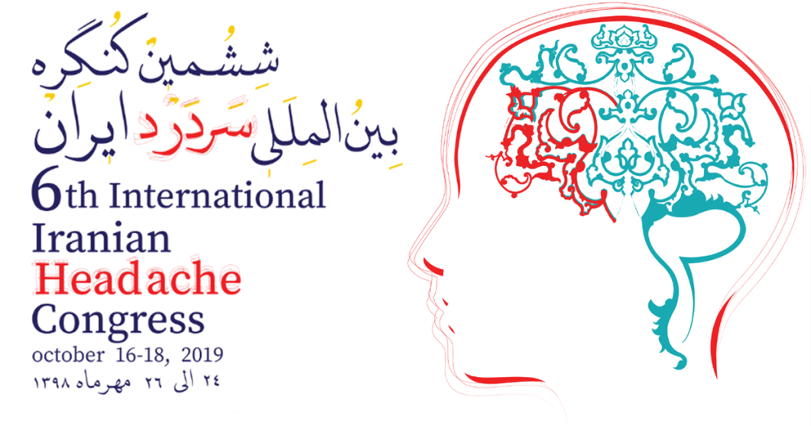
Medication-overuse headache
Fariborz Khorvash
Associate Professor Of Neurology
Isfahan University Of Medical Sciences
Headache Fellowship Course
Danish Headache Center

Slide 2
Headache present on 15 days per month
B. Regular overuse for more than 3 months of one or more drugs that can be taken for acute and/or symptomatic treatment of headache
C. Headache has developed or markedly worsened during medication-overuse(For simple analgesics and for combination of acute medications, the intake must be 15 days or more per month; for triptans, ergotamines, opioids, and combination analgesics,10 days per month is enough for a diagnosis of medication-overuse headache)

Slide 3
Epidemiology:
The prevalence of MOH in the general population in the western world is 1%–2%.
The review reported a wide range of prevalence, ie, 0.5%–7.2%.
The male to female ratio is 1:3–4, and the condition is most prevalent in the forties.
The prevalence seems to decrease with increasing age and the prevalence of MOH in children and adolescents has been suggested to be 0.3%–0.5% (20% of patients with chronic headache) .

Slide 4
Risk factors for MOH:
Primary headaches such as migraine and tension-type headache
Many psychosocial and socioeconomic factors (Depression and anxiety , low socioeconomic status with low income and education)
A high prevalence of smoking, elevated body mass index, and sleeping problems

Slide 5
Pathogenesis:
Alteration of cortical neuronal excitability, central sensitization involving the trigeminal nociceptive system
Low serotonin (5-HT) levels with reduction of 5-HT and higher frequency of CSD
Increase calcitonin gene-related peptide (CGRP) levels
Increased levels of orexin-A and corticotrophin-releasing hormone were found in the cerebrospinal fluid
Neuroimaging studies suggest changes in the orbitofrontal cortex and the mesocortico limbic dopamine circuit.

Slide 6
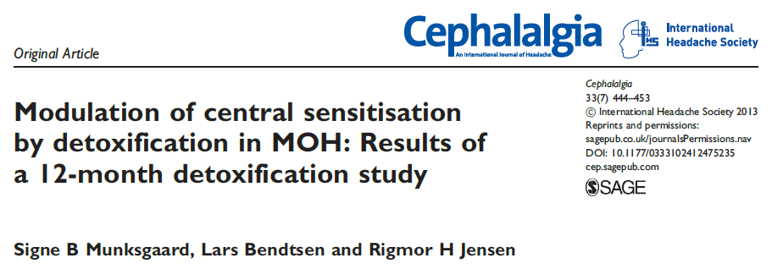

Slide 7
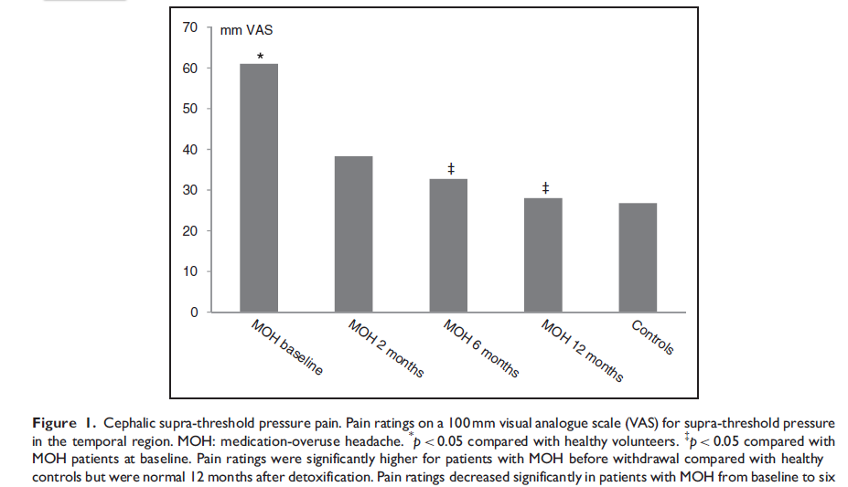

Slide 8
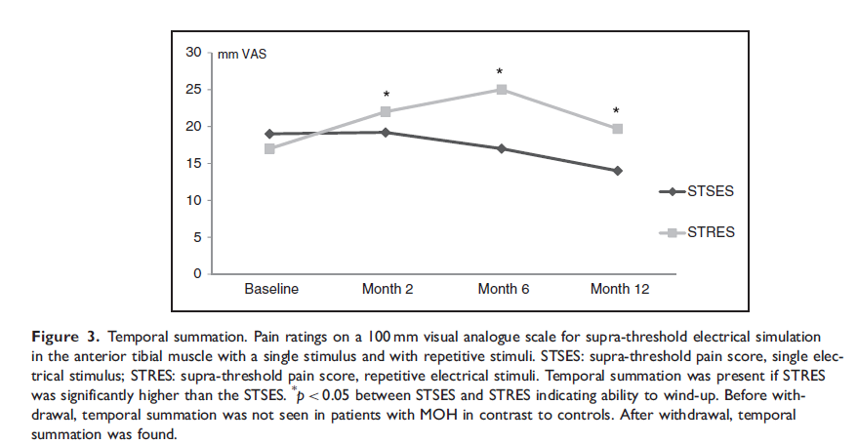

Slide 9
Medication dependence in MOH?
In two studies, approximately 70% of MOH patients fulfilled criteria for dependence according to the DSM-IV (Diagnostic and Statistical Manual of Mental Disorders, Fourth Edition).
In other studies, the dependence and personality profile score in the Minnesota Multiphasic Personality Inventory II (MMPI-II) did not reveal any differences between MOH patients, drug addicts, and controls.

Slide 10
In addition, recent studies in neuroimaging suggest an overlap of the pathophysiological mechanisms of MOH and substance-related disorders with changes in the orbitofrontal cortex and the mesocortico limbic dopamine circuit.
Based on today’s knowledge, it is impossible to ascertain whether the dependency-like behavior seen in those with MOH represents a real dependence or whether it is a form of “pseudoaddiction” secondary to frequent headache.

Slide 11
Treatment:
MOH is a treatable but very heterogeneous condition. A further challenge in the treatment is the fact that no worldwide consensus for the management of these patients exists. This may be due to the lack of randomized controlled studies, but also reflects differences in use of headache classification and treatment strategies across the world.
Whether or not to detoxify MOH patients initially and whether prophylactic medication should be initiated immediately at withdrawal or after withdrawal therapy has been completed are probably the most disputed areas in the treatment of MOH. Although recently debated, withdrawal of the overused medication(s) is regarded by most headache experts as the treatment of choice, since withdrawal of the overused medication(s) in most cases leads to an improvement of the headache.

Slide 12
Most patients experience withdrawal symptoms lasting 2–10 days after detoxification. The most common symptom is an initial worsening of the headache (rebound-headache), accompanied by various degrees of nausea, vomiting, hypotension, tachycardia, sleep disturbances, restlessness, anxiety, and nervousness. The duration of withdrawal headaches has been found to vary with different drugs, being shorter in patients overusing triptans than in those overusing ergotamine or analgesics.
Detoxification procedures vary widely and include both inpatient (2 days to 2 weeks) and outpatient withdrawal.

Slide 14
Study design
A two-month detoxification is recommended in the Danish treatment guidelines . Both A and B were out-patient programs, and all patients received exactly the same education, consisting of eight lectures managed by headache nurses in collaboration with specialized psychologists and physiotherapists.
Promethazine max. 75 mg per day) during the detoxification period. Pharmacological preventive treatment was initiated after detoxification ended, if indicated.

Slide 15
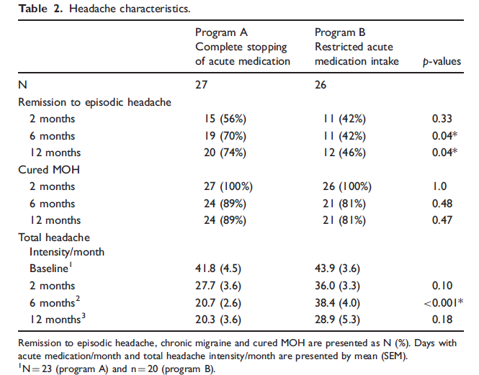

Slide 16
Zeeberg et al. reported that only 47% of patients actually needed preventive treatment at discharge after detoxification .
In Bendtsen study, preventive treatment was not indicated for 26% and 15% of patients, respectively, after successful detoxification. In other MOH studies, preventives were initiated before and/or during the detoxification period to relieve headache symptoms.

Slide 17
based on today’s knowledge, we suggest that initial withdrawal is the treatment of choice. Prophylactic headache medication should be restricted to patients who do not benefit sufficiently from cessation of medication-overuse, and those who have previously failed withdrawal attempts or have significant comorbidity.
Some authors contest this view since many MOH patients are already suffering and heavily disabled before starting a possible troublesome detoxification with withdrawal symptoms. However, it is an aim in itself to achieve a behavioral change and to restructure the approach from “have pain – take tablet” thinking to better ways of handling headache.

Slide 18
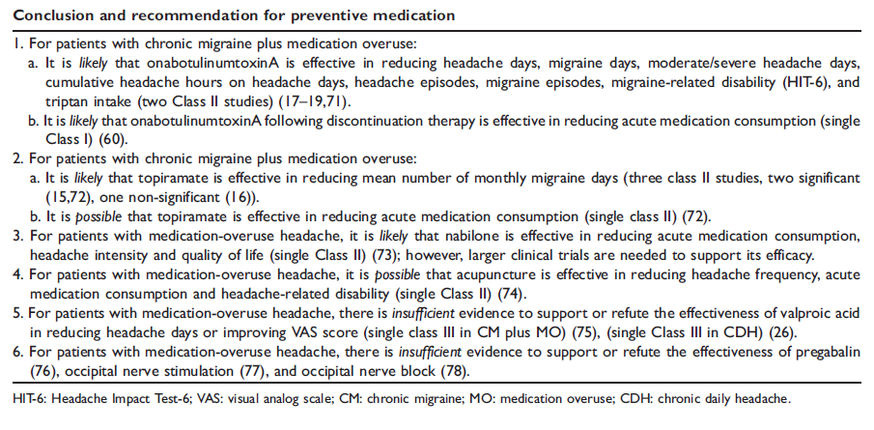

Slide 19
In the PREEMPT study (n¼904 with CM and medication overuse)
Onabotulinumtoxin A reduced headache days/month by 8 (approximately 40% from baseline) after 6 months.
Topiramate reduced migraine-days/month by 5.5 days (38%) in patients with CM with simultaneous medication overuse.
The CGRP antibody Erenumab reduced monthly migraine days by 6.6 after 12 weeks in patients with CM (41% with medication overuse) .

Slide 20
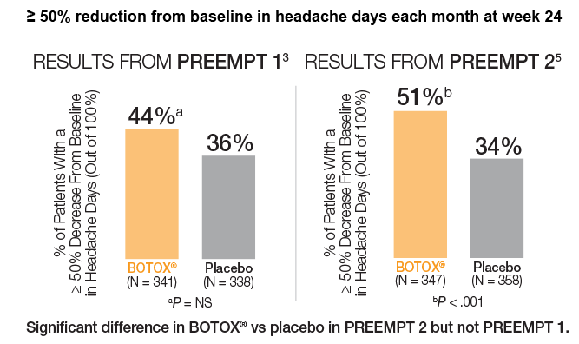

Slide 21
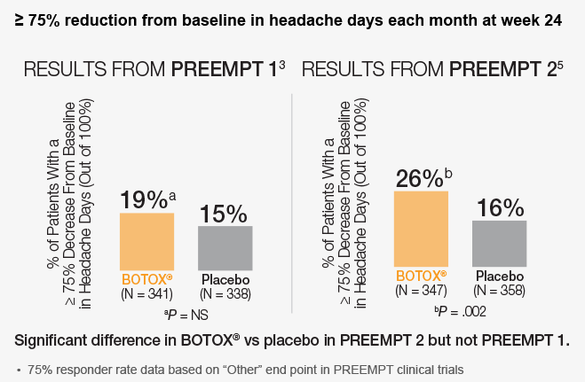

Slide 22
Thanks for your attention

